Slide 1
ESD Priority Inversion

Slide 2
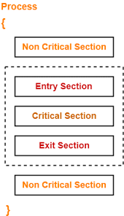
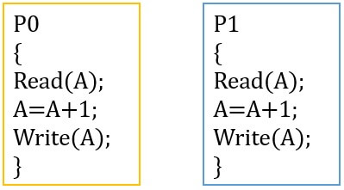
Critical Section
Semaphore/ Mutex
Critical

Slide 3
Few Points
We Assume:
a, b, c … can denote resources (e.g. memory, some sensor, etc)
P(a) means - locking/acquiring resource ‘a’
V(a) means - unlocking/releasing resource ‘a’
If a job J1 acquires a resource, no other job (not even higher priority ones) can get the same resource before J1 releases it
P(a)
V(a)
J1
Non C.S
C.S
Non C.S

Slide 4
Few Points
Some Tasks/Jobs/Process DO NOT have any critical section
On the other hand, Some Have.
Only 1 critical section (shown in prev page)
Multiple critical sections, maybe even nested, or one after another.
J1
Non C.S
P(a)
P(b)
V(b)
V(a)
J1
Non C.S
C.S
Non C.S

Slide 5
Few Points
A higher priority job can interrupt/preempt lower priority job, AT ANY POINT (even if the lower priority job is in critical section)
A higher priority job MAY or MAY NOT have critical section
(And Again) If a job J1 acquires a resource, no other job (not even higher priority ones) can get the same resource before J1 releases it

Slide 6
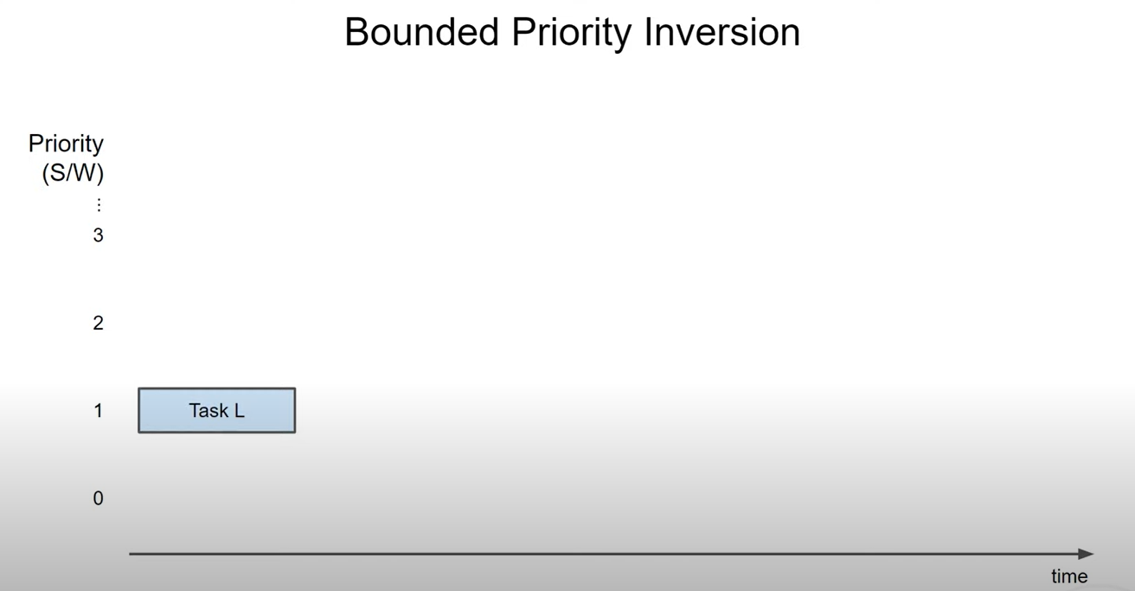

Slide 7
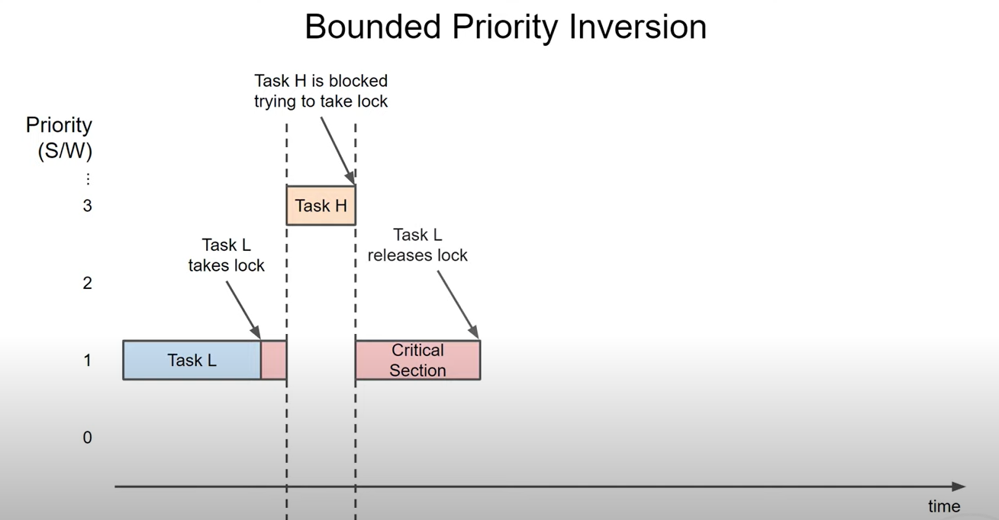

Slide 8
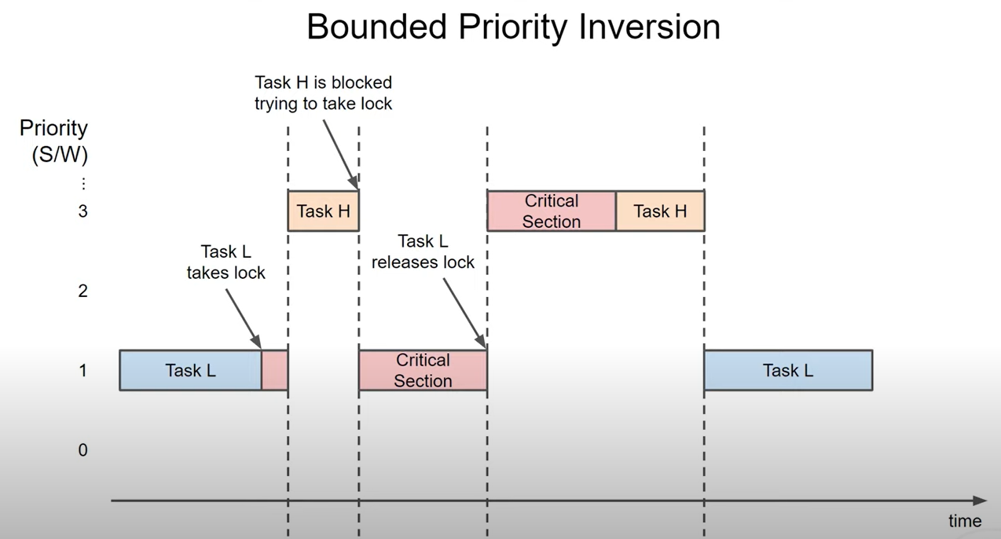

Slide 9
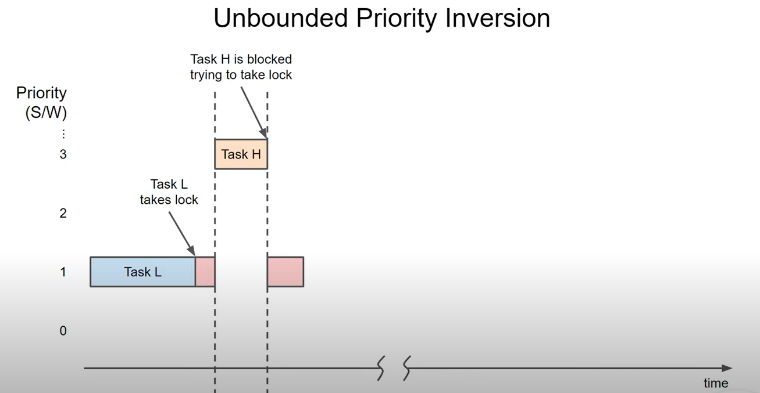

Slide 10
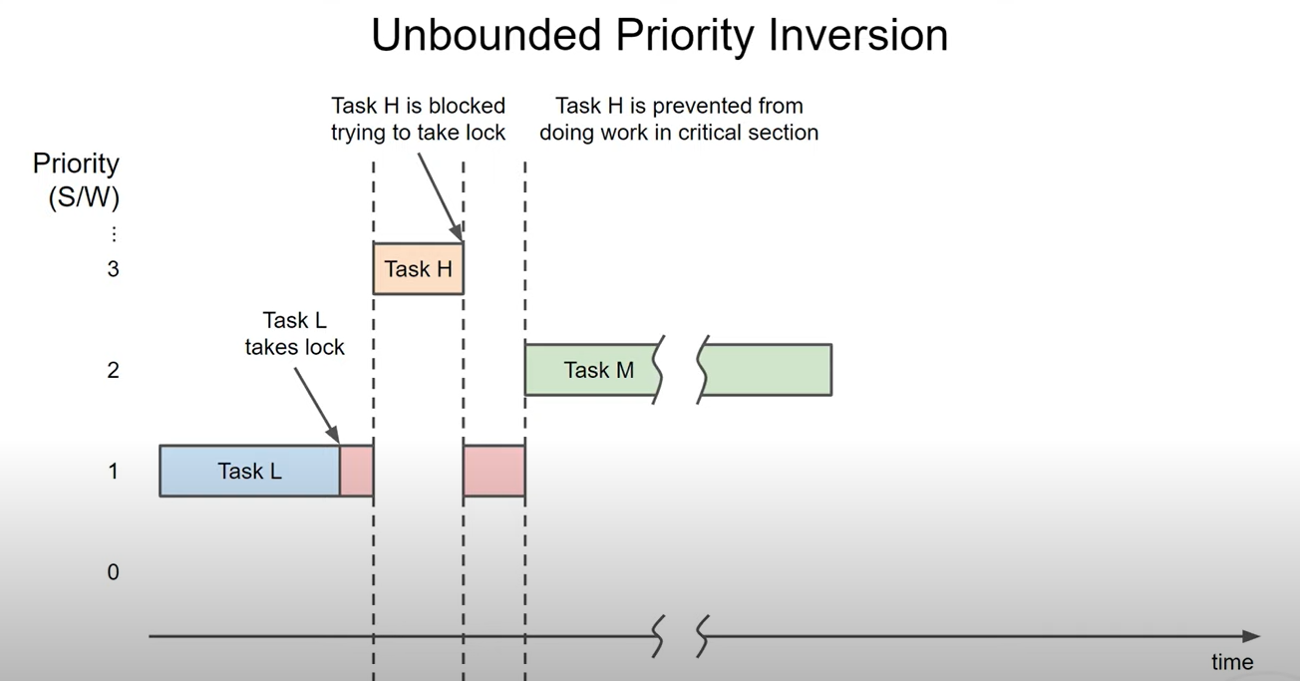

Slide 11
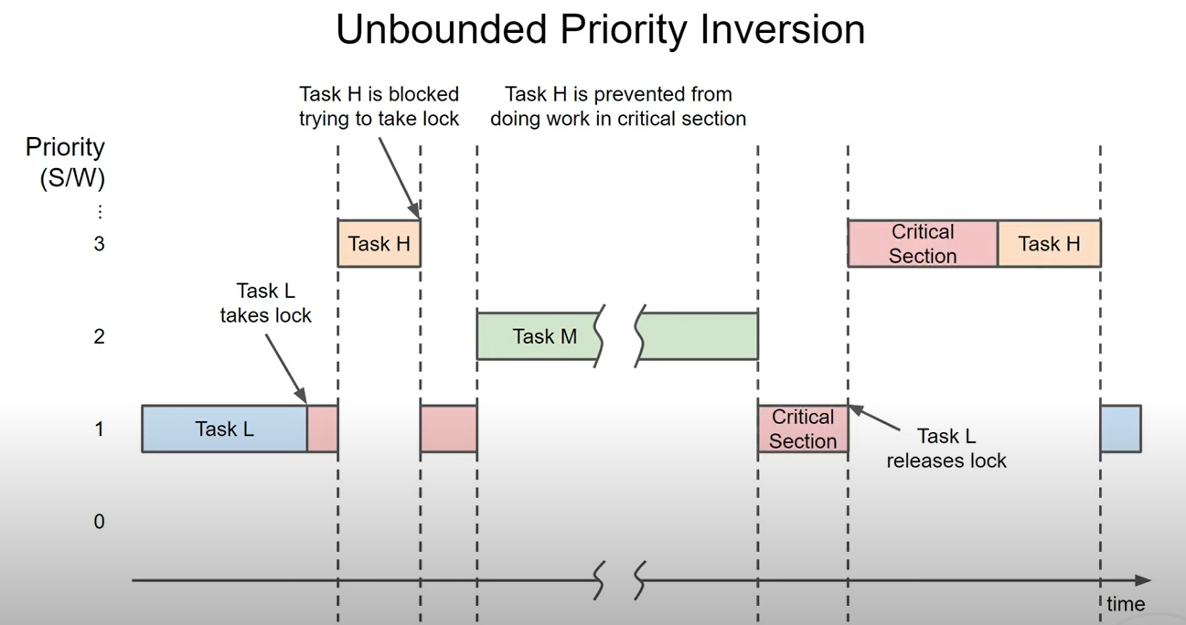

Slide 12
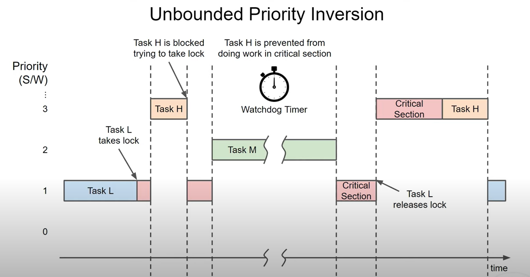

Slide 13
Solutions:
Priority Inheritance
Priority Ceiling

Slide 14
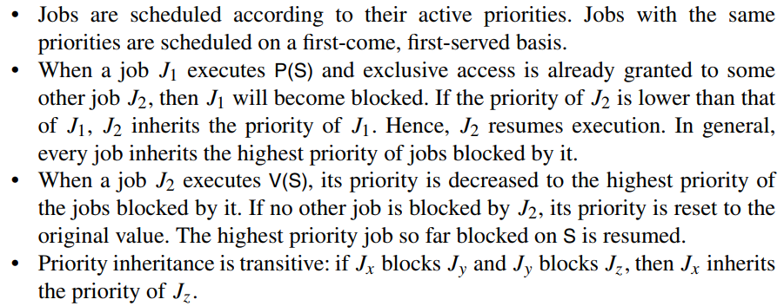
Priority Inheritance

Slide 15
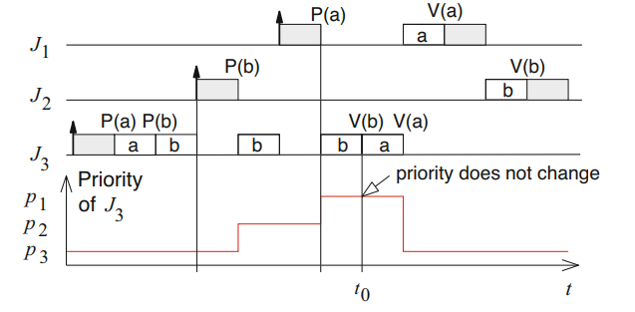
Priority Inheritance - Example 1

Slide 16
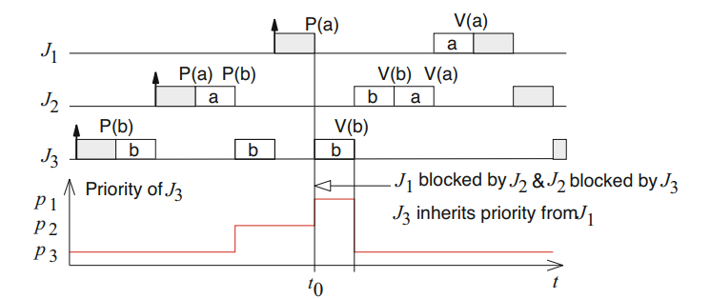
Priority Inheritance - Example 2

Slide 17
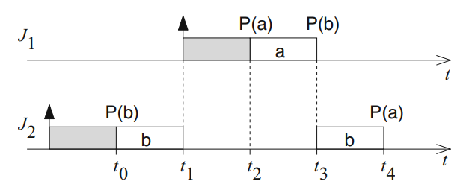
Priority Inheritance Deadlock

Slide 18
Priority Ceiling Protocol (PCP)
requires jobs to be known at design time.
PCP assigns priority to the RESOURCES
It is the priority of the highest-priority job that can lock that resource S at any point .
With PCP, a job is not allowed to enter a critical section if there are already locked Resources/semaphores which could block it eventually. Hence, once a job enters a critical section, it cannot be blocked by lower priority jobs until its completion.

Slide 19
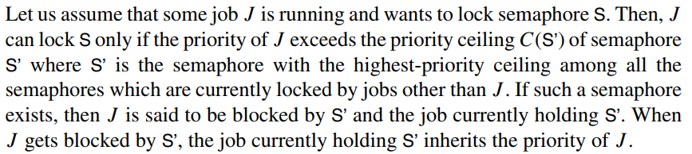
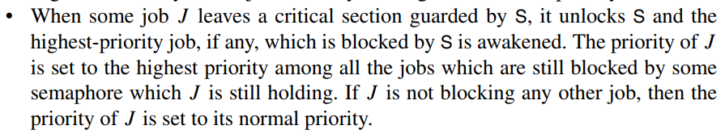
Priority Ceiling Protocol (PCP) Works:
#1:
#2:

Slide 20
PCP solving Deadlock (Example from previous)

Slide 21
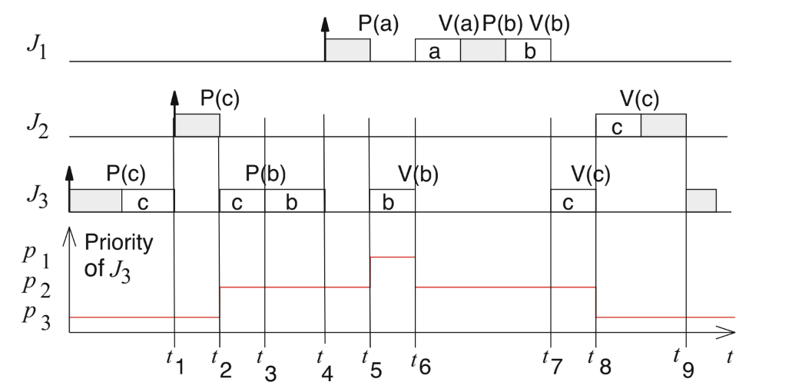
Priority Ceiling - Example 1

Slide 22
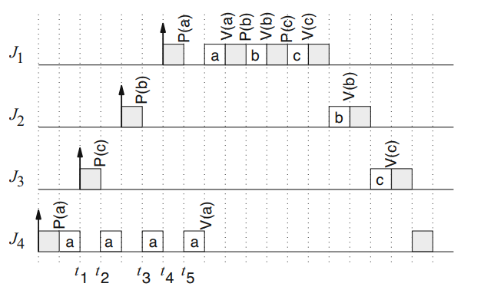
Priority Ceiling - Example 2

Slide 23
To Study:
Embedded System by Peter Marwedel
Chapter 4 (4.1 - 4.2.3)

